Slide 1


The Summaries of Technical Communication
the 2nd Semester of 2018 – 2019

Slide 2

Learning Patterns
Professional Skills
Cultural Studies
Ethical Research

Slide 3
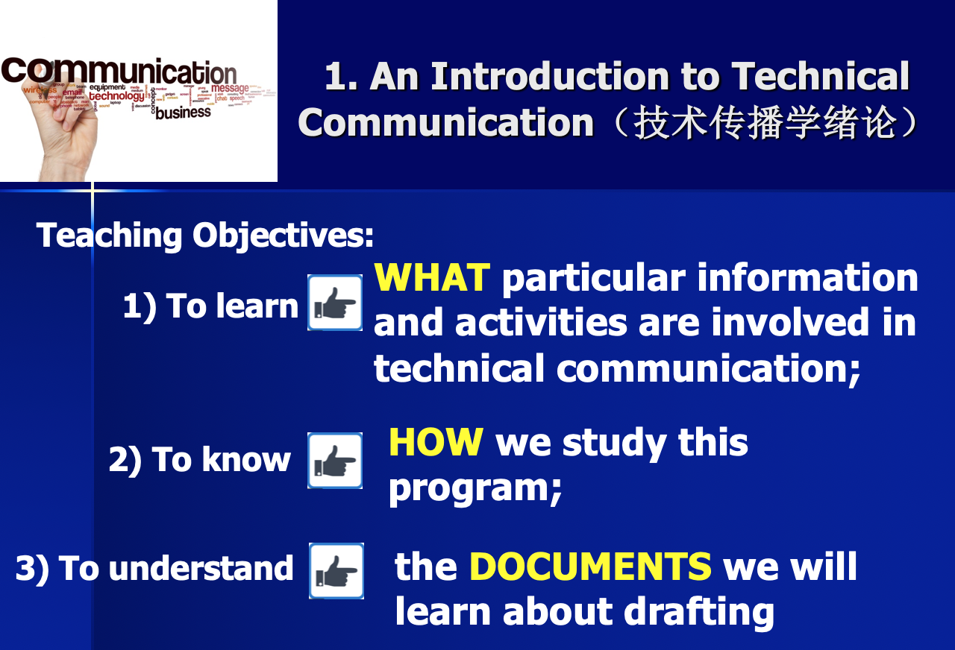
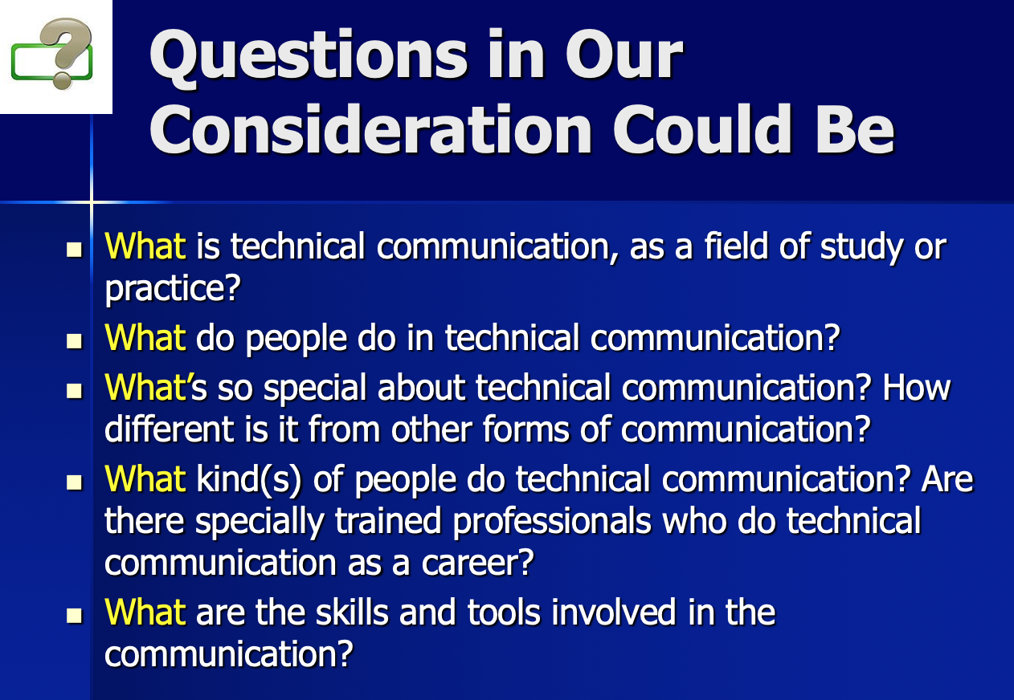
Introduction

Slide 4

CONTENTS
Emails for Work
Effective Memos
Résumés for Job Application
Instructions and User’s Manuals
1. Format Elements of Emails for Work
2. Tips on Drafting Emails for Work

Slide 5

Major Points
1. Format Elements of Emails for Work
Header, Message and Signature
2. Tips on Drafting Emails for Work
Netiquette Guidelines for Writing a Business Email

Slide 6
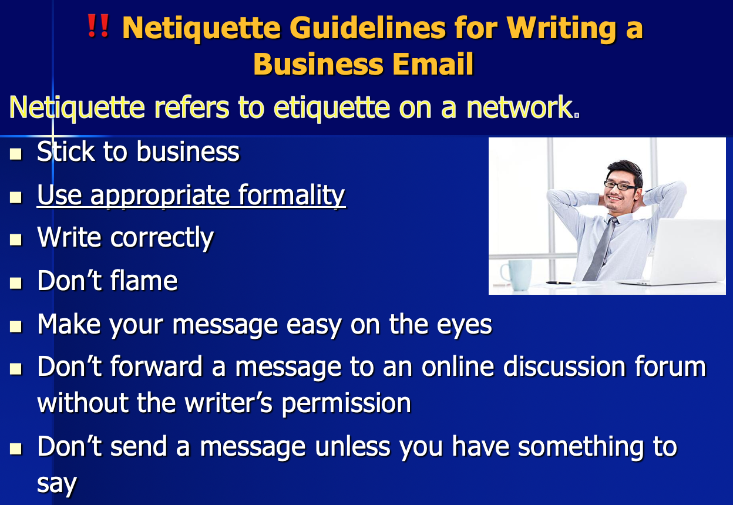
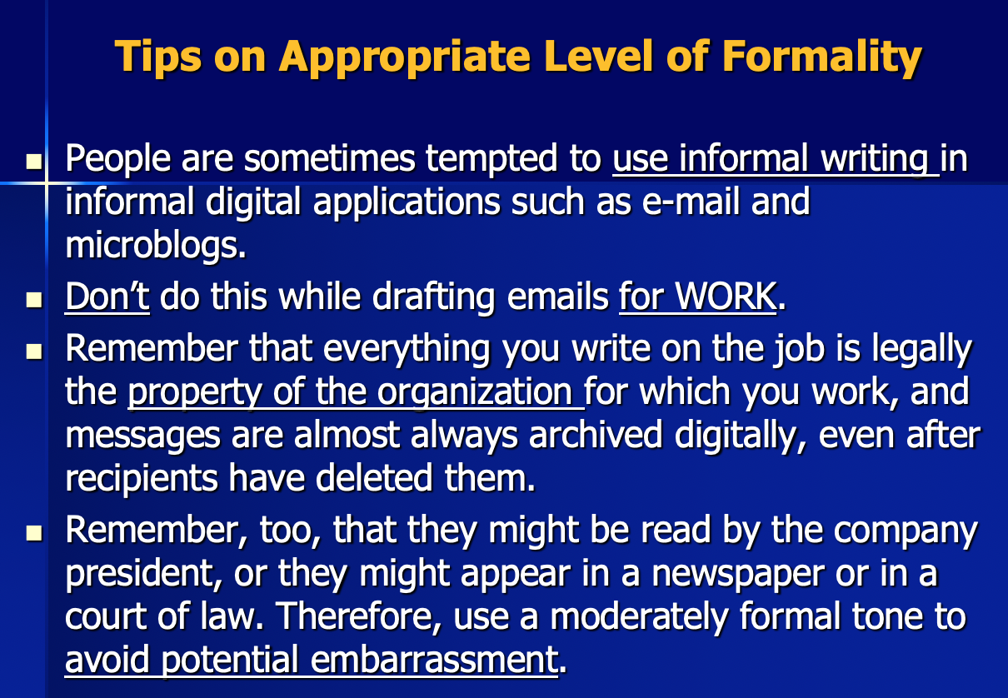

Slide 7
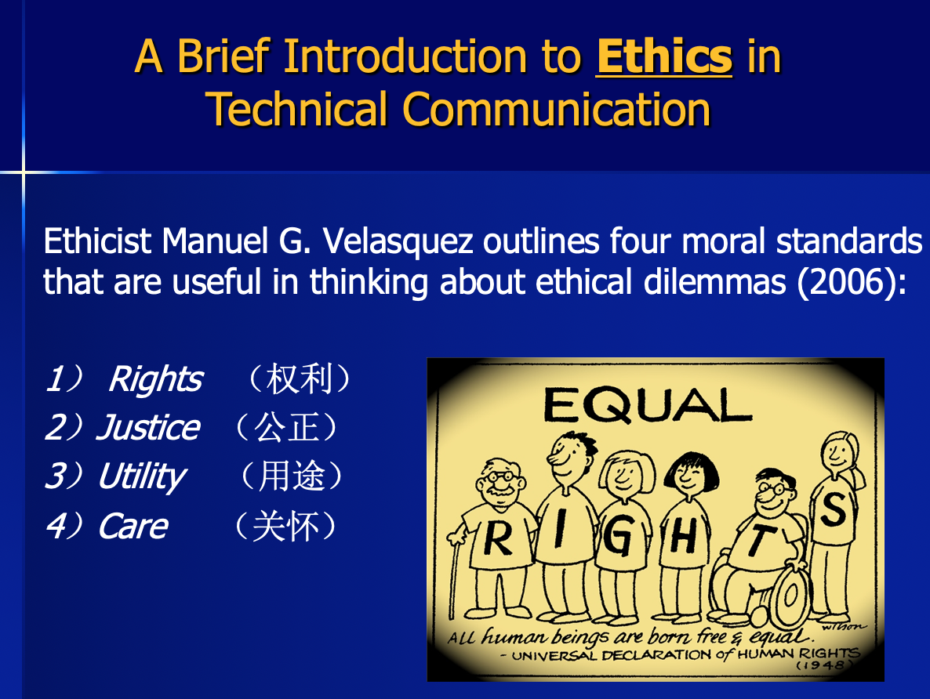
Ethical Research
Questions for Review:
Did you refrain from discussing nonbusiness subjects?
Did you keep the e-mail as brief as possible and send it only to appropriate people?
Did you use appropriate formality?
Did you write correctly?
Did you avoid flaming?
Did you write a specific, accurate subject line?
Did you use uppercase and lowercase letters?
Did you skip lines between paragraphs?
Did you keep the line length under 65 characters?
Did you check with the writer before forwarding his or her message?

Slide 8

CONTENTS
Emails for Work
Effective Memos
Résumés for Job Application
Instructions and User’s Manuals
1. Memo Structure and Components
2. Cultural Study and Ethical Research

Slide 9

Major Points:
Uses of Memos
Cultural Study
Cultural Practice
Language Use and Tone
Application Choice and Use
Map of Links
Structure of Memos
Ethical Research
How to Avoid Misleading the Readers?
Heading, Opening, Discussion, Closing, Signature (basic);
Attachment and Distribution (optional)

Slide 10
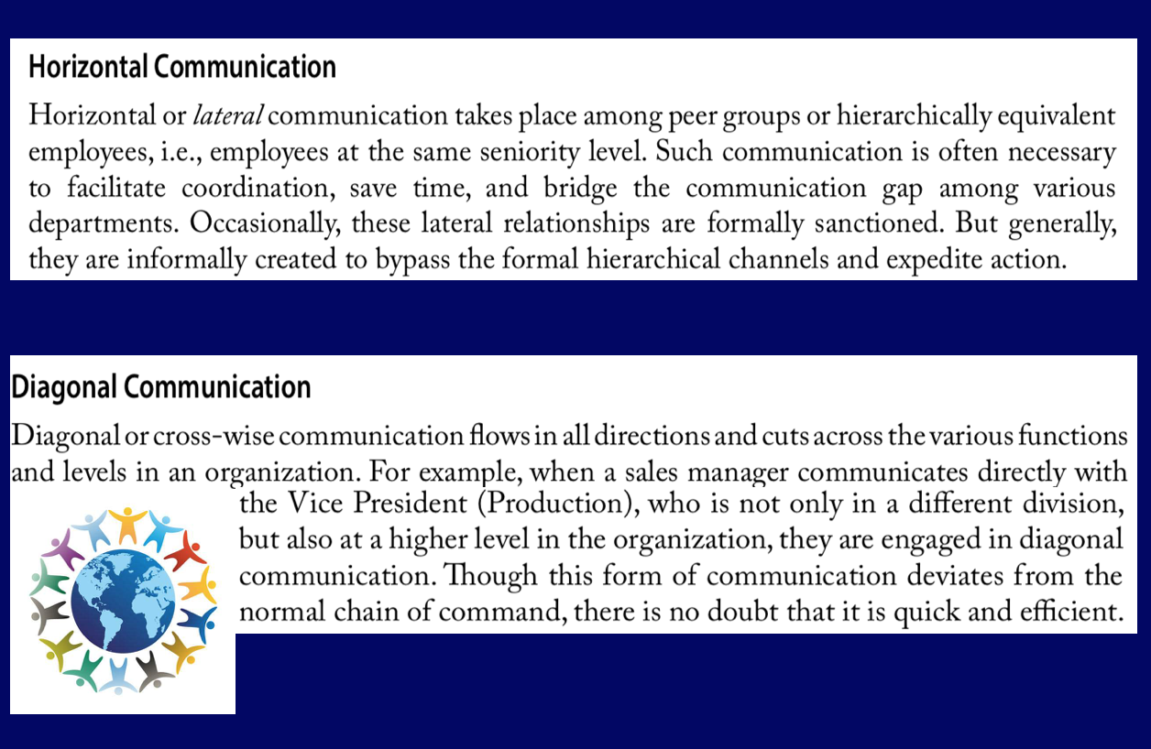
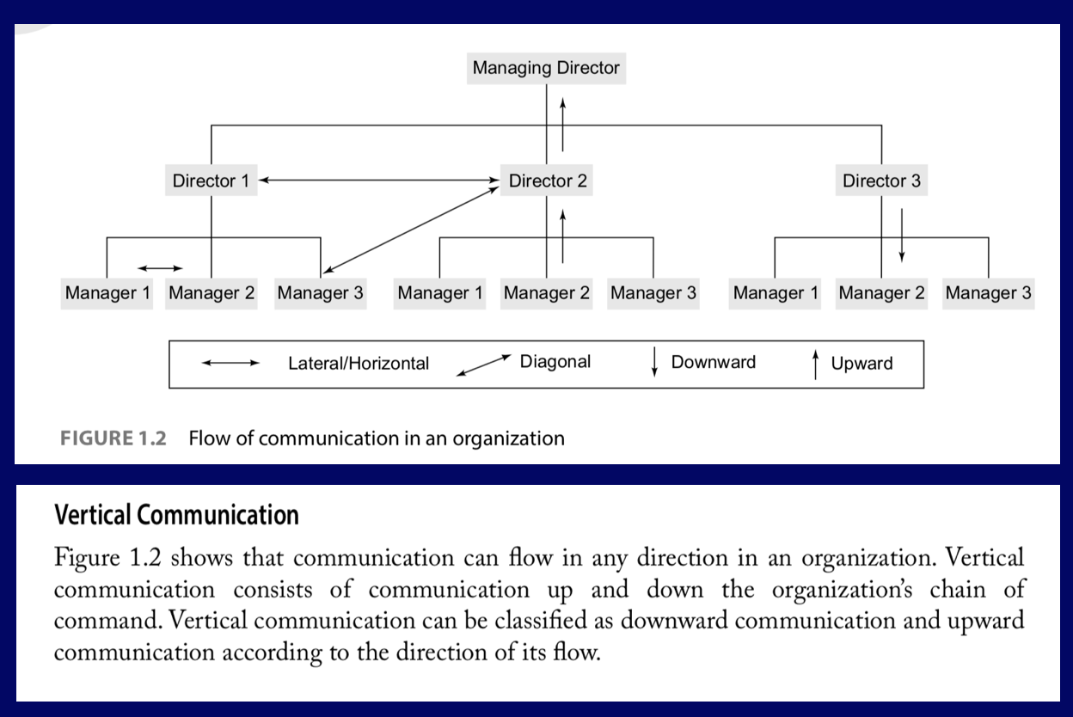
Map of Links

Slide 11
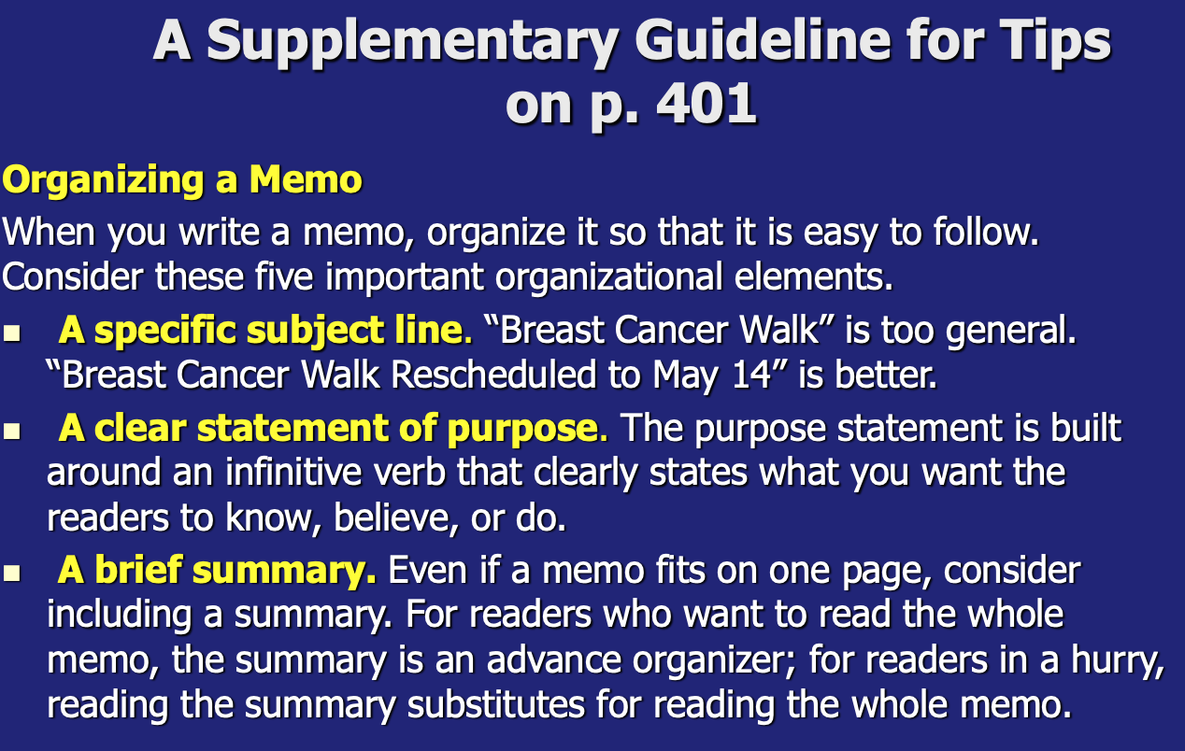
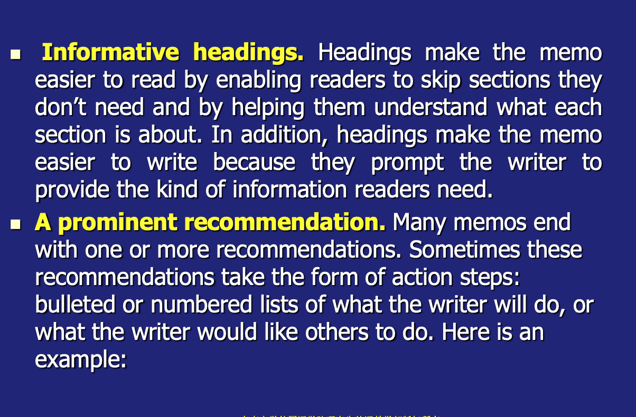
A Supplementary Guideline

Slide 12
Questions for Review:
Does the identifying information adhere to your organization’s standards?
Did you include a specific subject line?
Did you clearly state your purpose at the start of the memo?
Did you include informative headings to help your readers?
If appropriate, did you summarize your message?
Did you provide appropriate background for the discussion?
Did you organize the discussion clearly?
Did you highlight items requiring action?

Slide 13
CONTENTS
Emails for Work
Effective Memos
Résumés for Job Application
Instructions and User’s Manuals
1. Professional Skills
2. Cultural Study and Ethical Research

Slide 14
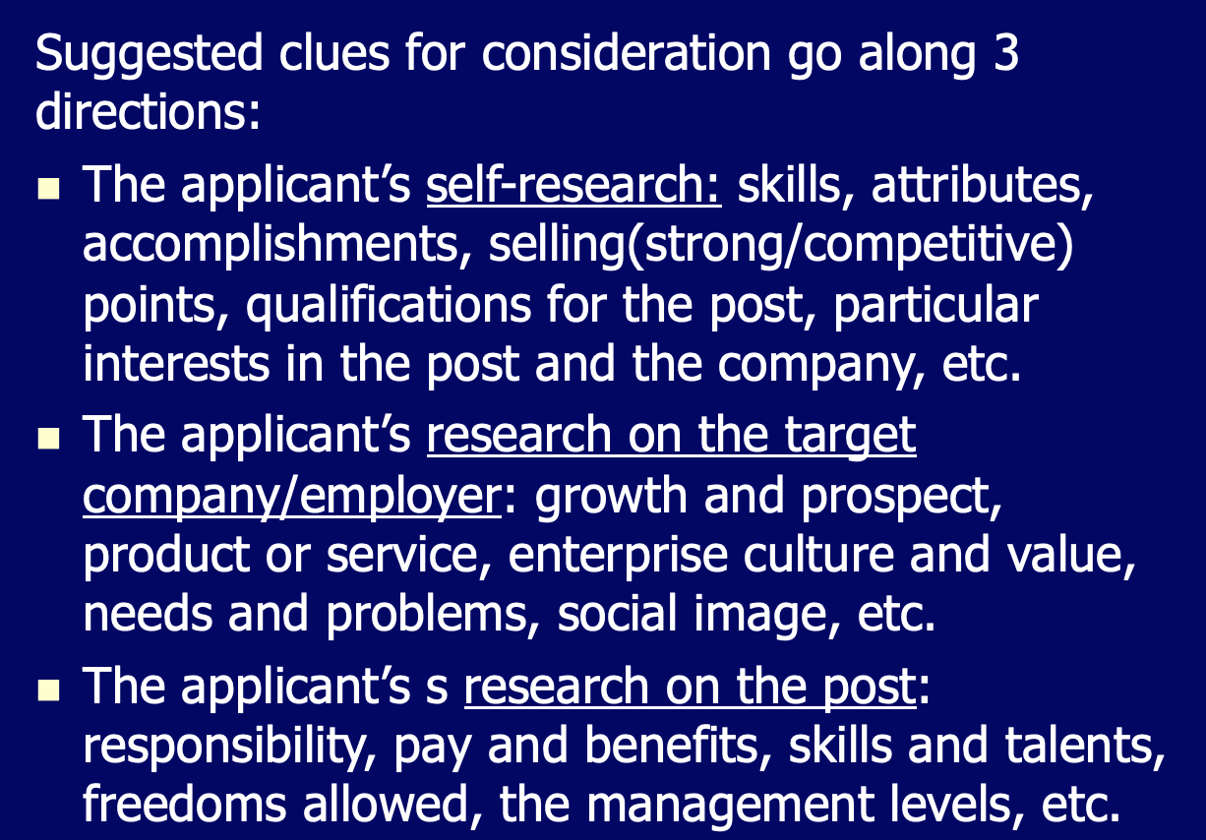
Professional Skills
Preparation

Slide 15
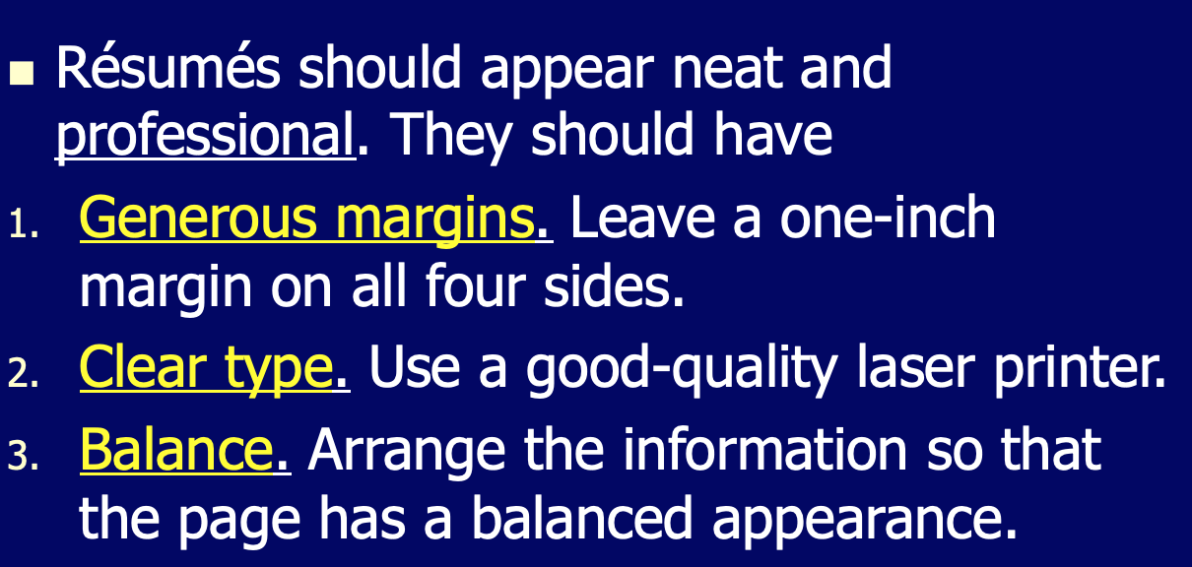
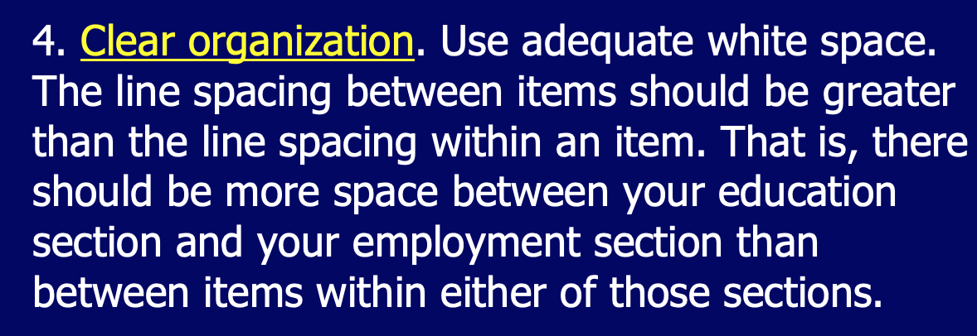
Professional Skills
Professional Appearance

Slide 16
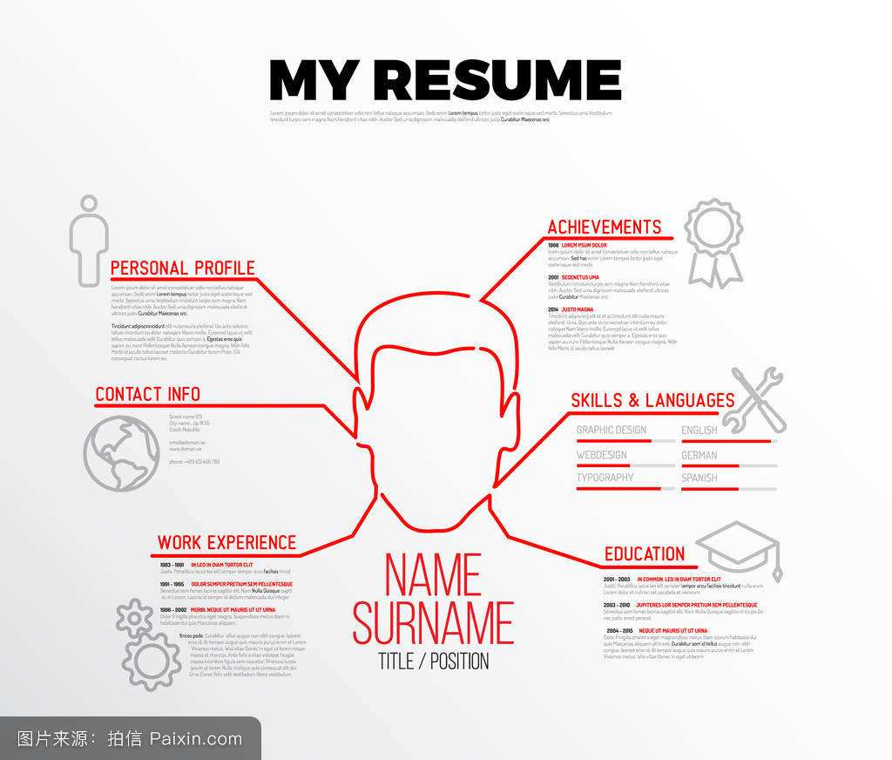
Major Points
Types of the Résumés
Basic Elements of the Chronological Résumé
Differences between the Chronological Résumé and the Skills Résumé

Slide 17
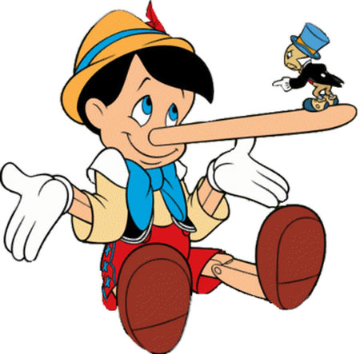
Cultural and Ethical Notes
Understanding of Honesty
Writing Honest Job-application Materials
Misconducts and Consequences

Slide 18
Questions for Review:
Does the résumé have a professional appearance, with generous margins, a balanced layout, adequate white space, and effective indentation?
Is the résumé honest?
Does the identifying information contain your name, address(es), phone number(s), and e-mail address(es)?
Does the résumé include a clear statement of your job objectives or a summary of your qualifications?
Does the education section include your degree, your institution and its location, and your (anticipated) date of graduation, as well as any other information that will help a reader appreciate your qualifications?
Does the employment section include, for each job, the dates of employment, the organization's name and location, and (if you are writing a chronological résumé) your position or title, as well as a description of your duties and accomplishments?
Does the interests-and-activities section include relevant hobbies or activities, including extracurricular interests?
Does the references section include the names, job titles, organizations, mailing addresses, and phone numbers of three or four references?
Does the résumé include any other appropriate sections, such as skills and abilities, military service, language abilities, or willingness to relocate?

Slide 19
CONTENTS
Emails for Work
Effective Memos
Résumés for Job Application
Instructions and User’s Manuals
1. Professional Skills
2. Cultural Study and Ethical Research

Slide 20
Major Points
1
2
3
4
Preparations
Ethical Notes
Drafting
Manuals
1. Definition of Instructions;
2. Guidelines for Designing Clear and Attractive Page
Safety Concerns:
3 Key Words
4 Elements
Difference between the Instructions and the Manuals

Slide 21
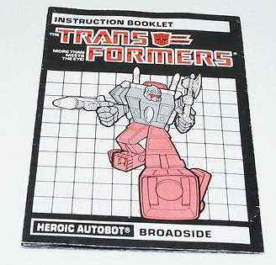
Preparations
Definition of the Instructions
(1) Understanding
(2) Descriptions Involved
Guidelines for Designing Clear, Attractive Pages
(1) Creating an Open, Airy Design
(2) Clearly Relating the Graphics to the Text

Slide 22
Drafting Effective Instructions
A Title
(1) Being Simple and Clear
(2) Two Forms:
How–to
Gerund
To Avoid the Noun String
A General Instruction
Basic Consideration on 6 Aspects: Who, Why, When, What Safety Measures, What Items, and How Long

Slide 23
Drafting Effective Instructions
Step-by-Step Instructions
8 Tips for Effective Drafting
To Use the Imperative Mood;
To Avoid the Passive Voice
A Conclusion
Stating that the reader has now complete the task or describing what the reader should do next;
Ending with Maintenance Tips or A Troubleshooting Guide

Slide 24
Questions for Review:
Are the instructions designed effectively, with adequate white space and a clear relationship between the graphics and the accompanying text?
Do the instructions have a clear title?
Does the introduction to the set of instructions state the purpose of the task? Does it describe safety measures or other concerns that readers should understand? Does it list necessary tools and materials?
Are the step-by-step instructions numbered? Are they simple and direct?
Are appropriate graphics included?
Does the conclusion include any necessary follow-up advice? Or if appropriate, a troubleshooting guide?

Slide 25




Good Luck!
&
Best Wishes!

